Slide 1
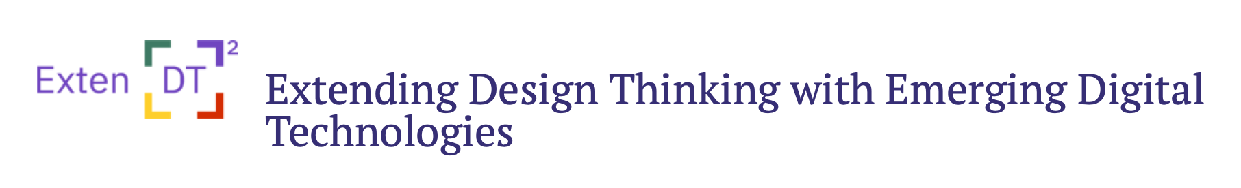

Teaching with Design Thinking and Digital Technologies
A professional development training offered by the European-funded project Exten(DT)2 https://extendt2.eu/

Slide 2
Before the session:
Create accounts for all teachers:
Extendt2 platform
nQuire for students
Share the accounts and URLs of the two platforms with participating teachers
Ask teachers to log in and have a look before the session - ask them to email you if they cannot access the platforms (solve any technical problems before the session).
Give links to example activity plans (one each technology) in case some teachers want to have a look beforehand
Before the start of the session, share "key terminology" slide with teachers (See next slide)

Slide 3
Key terminology
Exten (DT)2= "Extended Squared", the name of the research project this training relates to; it stands for "Extending Design Thinking with emerging Digital Technologies"
design thinking= a process of problem solving that can help to develop 21st-century skills by co-creating, piloting, and improving solutions.
21st century skills= critical thinking, creativity, problem solving, etc
prototype= an artefact students create or develop (physical or digital)
empathise= understanding what others think, feel, need
ideate= come up with different solutions for a problem
Exten(DT)2 model= a model to help teachers use design thinking and technologies in the classroom
Exten(DT)2 platform= an online platform that hosts tools used in design thinking, including the below:
Choico= a simulation game about the consequences of the choices we make
Sorbet= a sorting game
Malt2= a game for creating 2D and 3D shapes
nQuire for students= a tool to collect data from others
GearsBot= a virtual robotics tool
Activity plan template= a template to help teachers structure and design activities for their students

Slide 4
Our norms for today...
We treat each other with respect.​
We listen carefully while another person is speaking.​
We respect all others' right to speak and share their thoughts – we should not dominate the discussion.​
We should direct arguments toward opinions and ideas, not the individual stating them.​
We can ask questions at any time.
There are no wrong questions or wrong answers!​ We are all here to listen and learn from each other!

Slide 5
Contents:
Part 1 (1 hour):
The Exten(DT)2 project
Learning outcomes
Design thinking
Activity 1 (added value of technology)
Models of design thinking
Break
Part 2 (1 hour):
Activity 2 (use of technologies)
Break
Part 3 (1 hour):
Activity 3 (writing my own activity plan)

Slide 6
What is this project about?
Design thinking = a process of problem solving that can help to develop 21st-century skills by co-creating, piloting, and improving solutions.
Design thinking rarely used in education (mainly industry)
21st century skills e.g., critical thinking, collaboration, creativity, problem-solving
Key components of Extended Squared - Exten(DT)2 - project:
Design Thinking
Technologies
21st century skills

Slide 7

Visit the project website: https://extendt2.eu/
In this project…
….we use innovative technologies to apply design thinking at schools in an easy and effective way
…. technologies are designed at our institutions and are based on Artificial Intelligence (AI), Augmented Reality, 3D printing/scanning and virtual robotics.
….we will produce guidelines about how to use design thinking and technologies at schools across Europe (context- and country-specific).
Notes:
Find more info about the project
Read project news and updates
Find material and resources you can use to teach
Try project technologies
Take art in the project

Slide 8
Learning outcomes:
After attending this professional development training, you should be able to:
Explain to your students what design thinking (DT) is and why it is useful (model, vocabulary, examples)
Find out about 6 innovative digital technologies to use in design thinking projects (you will use 2 of these in this session)
Understand the added value of using digital technologies to design DT activities
Identify a problem relevant to your students' needs that can be solved using DT and technologies
Develop an activity plan you can implement with your students next time you go to school!

Slide 9
Introductions….(15 min)

Slide 10
Who are the facilitators?
Who are the teachers?
Organisation
Role in the project
An interesting fact/thought about the project
Years of teaching or studying to become a teacher
Any past experiences with Design Thinking
Any past experiences of using technology in the classroom
Why did you join this training?
What do you hope to get out of it?

Slide 11
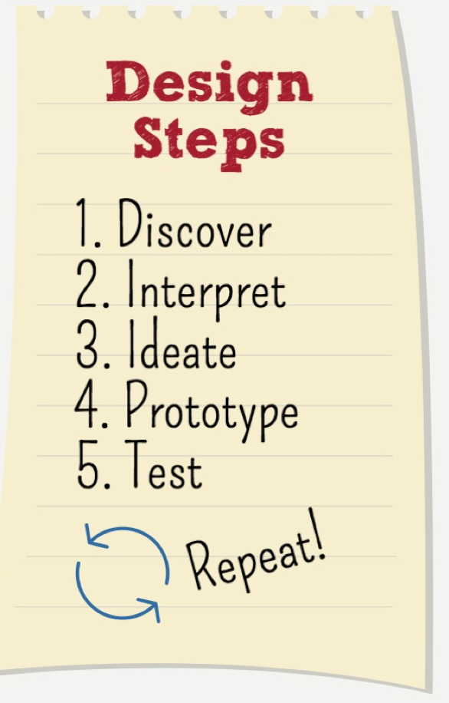
What is design thinking?
…is a human-centred approach to learning, collaboration and problem solving
…a process through which you can identify a challenge, gather information, come up with possible solutions, refine, and test your solutions.
….the process is circular and iterative - you should reflect on each stage of design thinking and revise it
…is a mindset - a way of thinking and working
…is used by designers (in real life) when they try to innovate
https://tll.gse.harvard.edu/sites/projects.iq.harvard.edu/files/hgsetll/files/designthinkingeducation.pdf

Slide 12
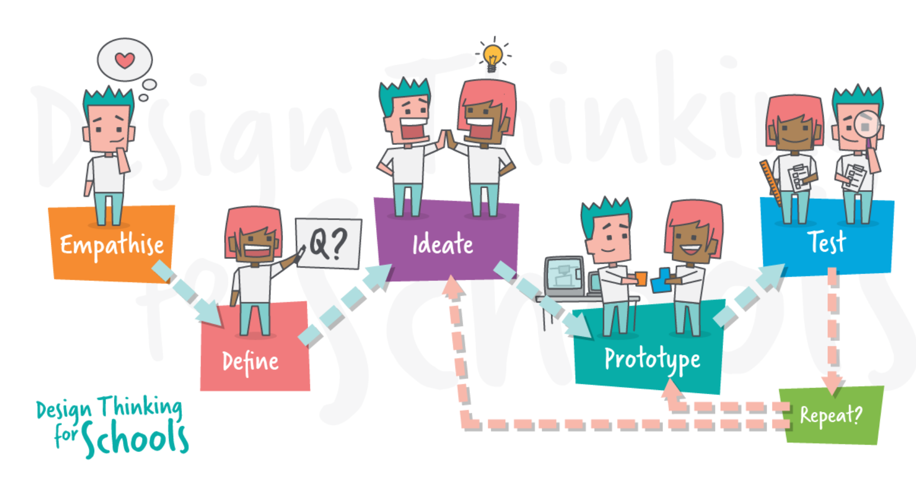
Why is design thinking important?
In a changing world, future citizens need to be flexible and adaptable and ready to cope with situations they haven't seen before. Design thinking is a great tool to:
To develop confidence to respond and adapt to challenges
To be able to develop innovative and creative solutions to the problems they face
To become active and empathetic members of society that can contribute to solving complex issues (e.g. pollution, climate change)
To develop 21st century skills
I
https://www.makersempire.com/what-is-design-thinking-a-handy-guide-for-classroom-teachers/
Notes:
Very relevant and timely because…

Slide 13
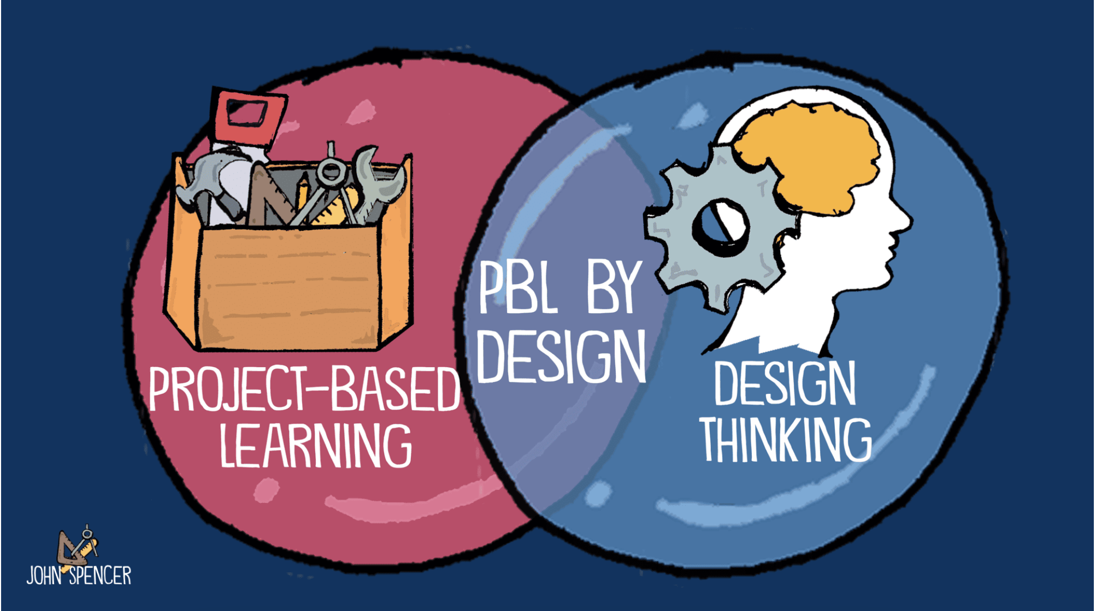
How is design thinking different to problem-based learning?
Student voice and choice (greater motivation) e.g. students come up with their own solutions, students co-create the driving question
Starting point is the understanding of end-users needs, feelings, perspectives, and challenges ("empathise")
A solution is created/crafted/developed by students rather than just found
Design thinking can give structure to problem-based learning
Real life, complex problems, authentic learning situations
https://spencerauthor.com/pbl-by-design/#:~:text=In%20other%20words%2C%20PBL%20provides,experience%20works%20with%20design%20thinking.
Notes:
Co-creation of question example: if your driving question is "How can we reduce food waste in our school?", you can ask your students to narrow it down to a specific aspect, such as "How can we compost food scraps in our classroom?" or "How can we create a campaign to raise awareness about food waste in our cafeteria?". https://www.linkedin.com/advice/0/how-do-you-engage-students-voice-choice

Slide 14
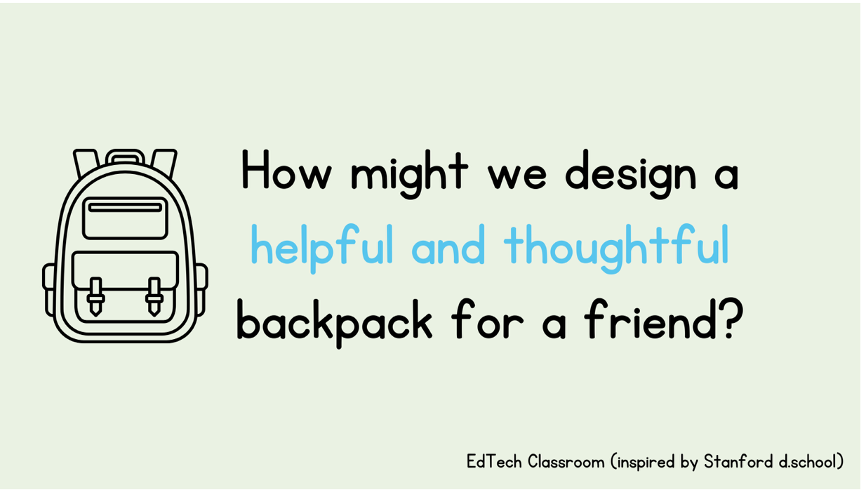
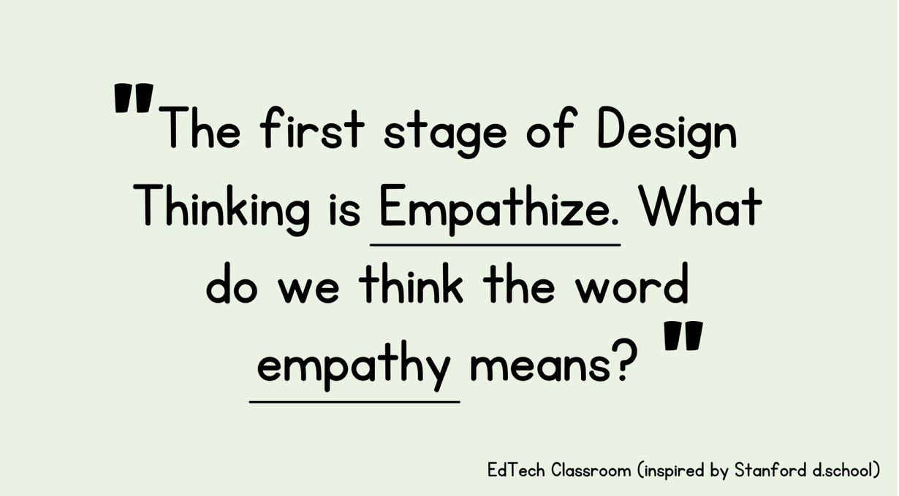
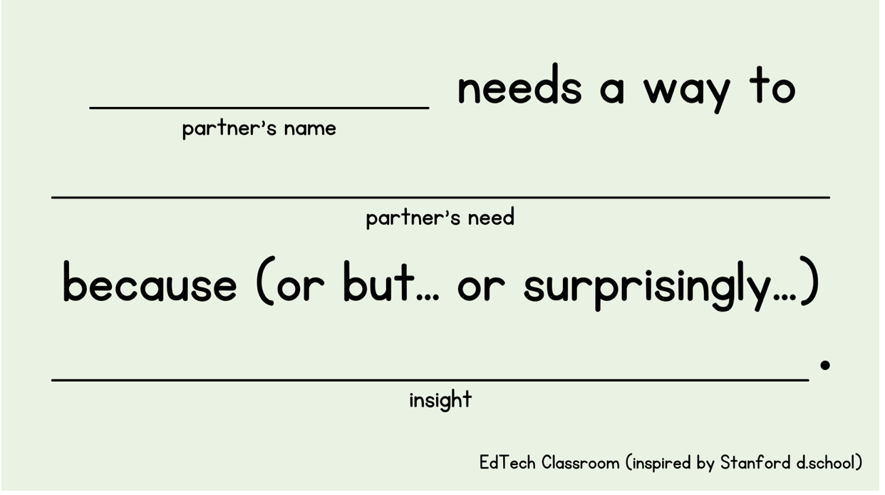
An example of a design thinking project in a class
https://edtech-class.com/2021/08/26/design-thinking-project-ideas-for-elementary-classrooms-and-back-to-school/
Notes:
To gain an indepth understanding of the problem they need to "empathise"

Slide 15
Notes:
Potential questions for students to ask their partners: Walk me through the contents of your backpack (or tote bag, etc.), Why do you have a particular item in your backpack? When do you carry your backpack?What do you primarily use your backpack for?

Slide 16
Notes:
Draw conclusions from analysing data they collected from other students and use this to define the problem: “Maddie needs a way to carry her books to class more easily because she loves to read but does not have enough space.”

Slide 17
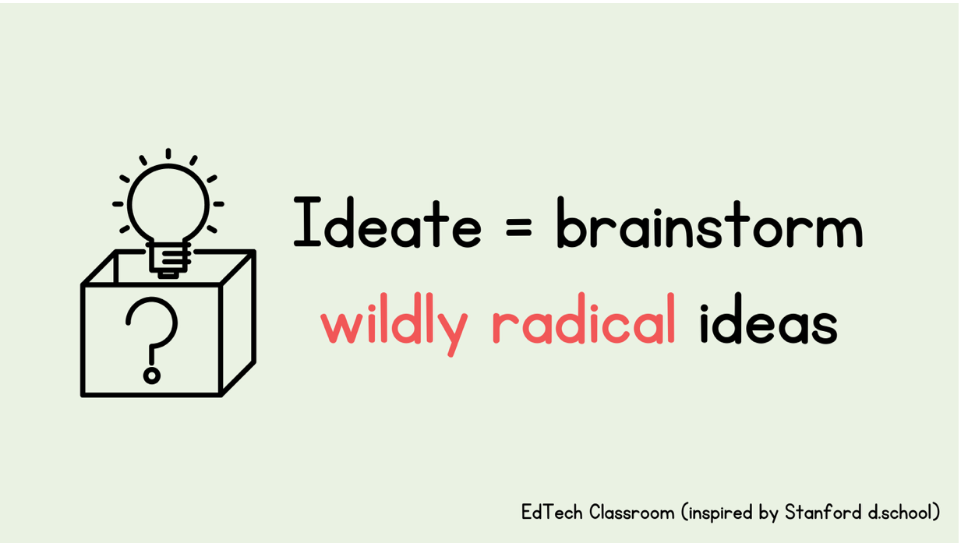
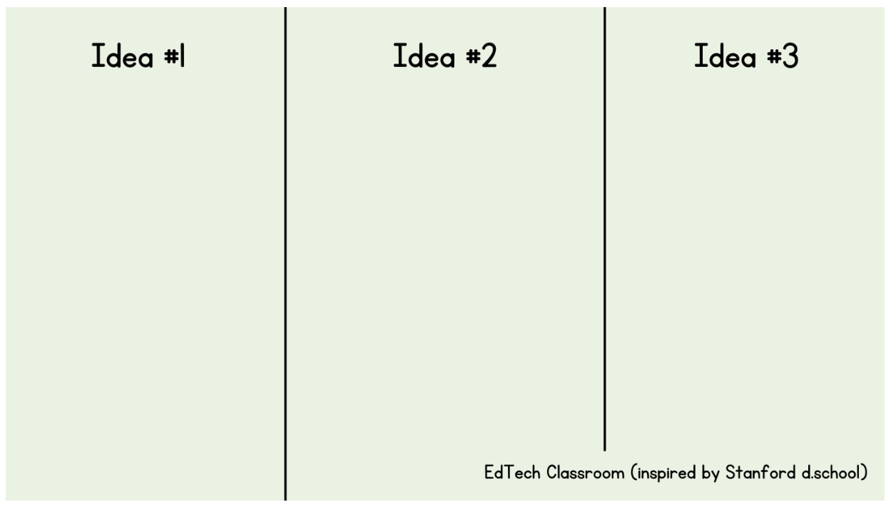
Notes:
IDEATE phase: Brainstorming solutions and ideas in response to the student needs - draw or write ideas on a piece of paper

Slide 18
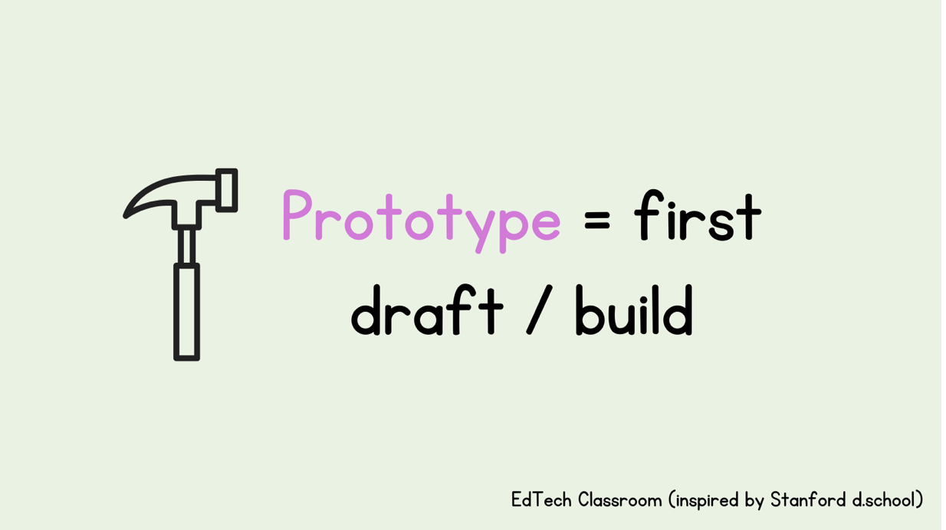
Notes:
Build ideas with material and explain why you choose specific material for the bag e.g. durability, noise level. recyclable materials (think: cereal boxes, paper towel tubes, plastic water bottles) to build their prototypes

Slide 19
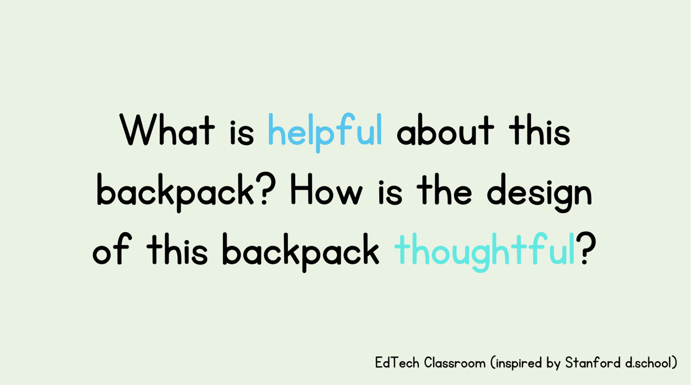
Notes:
Test stage - In the Backpack Project, students would show their prototypes to their partners, and get feedback and additional ideas on how to improve their designs.
What does their partner like about their backpack? What is helpful about this backpack? How is the design of this backpack thoughtful?

Slide 20

What are the outcomes of a design thinking project?
Design as making
new products, services, designs (e.g. 3D printed artefact)
Design as thinking
New ways of thinking (enhanced learning, changes in behaviour)
Understanding multiple perspectives
Iterating and revising ideas
Being flexible and adaptable
In the classroom:
game artifacts (digital or physical)
presentations/pitch videos with new ideas
https://www.hotjar.com/design-thinking/

Slide 21
What activities can we use to teach design thinking?
How can technology help us do this better?
Notes:
Introductions+presentation of slides till here= 15 min + 20min= 35 min approx

Slide 22
Activity 1: Group work, break out rooms (15 min)
Think of the backpack example…
What activities would you normally do to teach students:
how to "emphathise" (collect data from others about what they think, feel, need)
how to amend and improve "prototypes" or solutions?
How could you teach the above with the help of technology (think of any technology tools you know)?
Could technology help you to teach in an easy and more effective way?
*Note down main points and share in plenary.
Ideas for activities:
https://docs.google.com/document/d/1TpG7dt9ci_giDeyFGn_PV_XhDN3_X3HBPPwwPxH5vIQ/edit

Slide 23
Models of design thinking
Notes:
Several models, mainly in how DT can be used in industry or higher education teaching - the next slides are only for reference and show then quickly that the DT process has been conceptualised in different ways

Slide 24
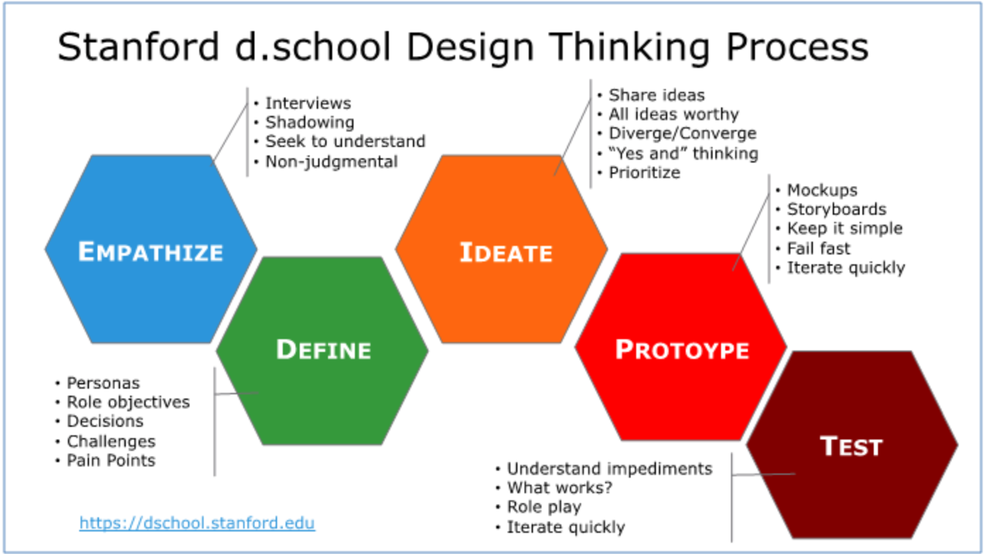
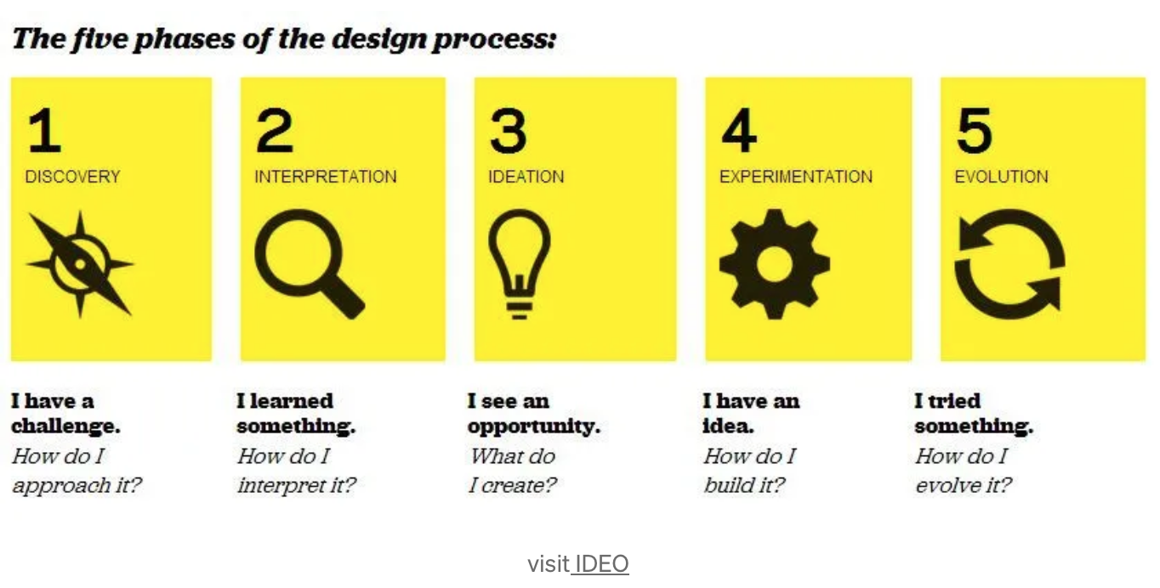
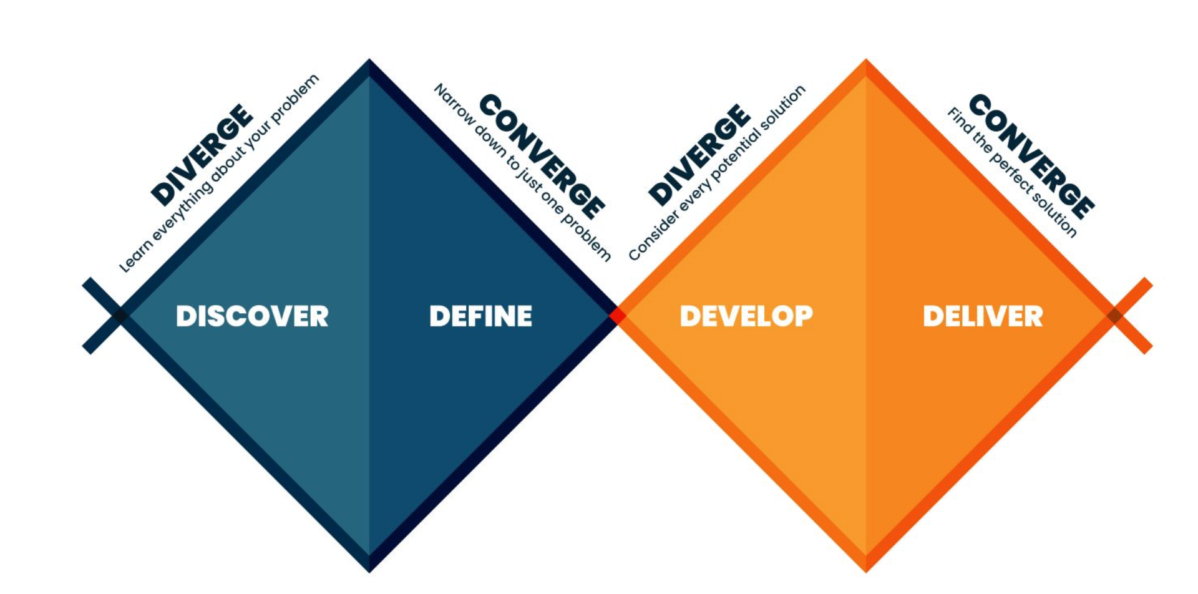
Notes:
Briefly mention each to give a flavour

Slide 25
The Exten(DT)2 model:
A practical model for using design thinking in the classroom
Why a new model? Reflecting on year 1 project activities with teachers and students across Europe (in which we used the Double Diamond Model), we identified the below:
Need to showcase to students the fact that each design thinking step is used to inform the next one
Need to stress the importance of "empathise", as a key feature of design thinking
Need for a model that is self-explanatory and easy to understand (language matters)
Need for a model that meets curricula requirements in particular, the need for student assessment
A model that showcases the added value of using technologies to apply design thinking in the classroom
Fully digital version: all phases of design thinking are delivered using technologies
Hybrid version: some phases of design thinking are delivered using technologies
Notes:
We came up with a model that can be fully digital and a model that can be hybrid - in terms of at which point technology is used across DT stages

Slide 26
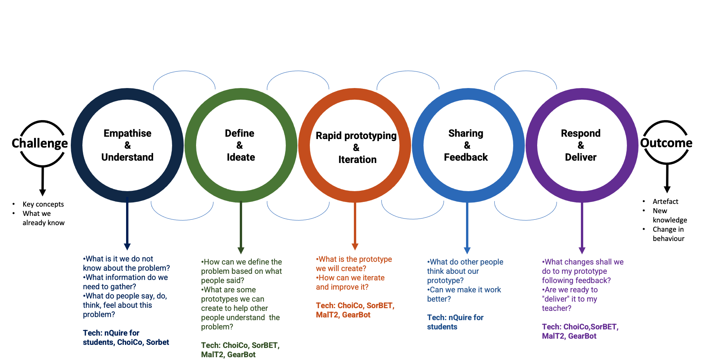
The Exten(DT)2 model of digital design thinking
See original version here:
https://docs.google.com/presentation/d/1N0y-ppaatWsF05JF8m10dCaKCGpf7IJR/edit?usp=sharing&ouid=117068169821130063488&rtpof=true&sd=true
Notes:
Revised following our online meeting.

Slide 27
Break time…5 minutes

Slide 28
Activity 2: Digital technologies and Design thinking
"Imagine you are a student and you are asked to use design thinking and a set of technologies to address the issue of:
”Energy consumption at school"
Notes:
In this scenario, the issue is given by us - alternatively, you can ask students to discuss and identify which issues they would like to explore and find solutions for.

Slide 29
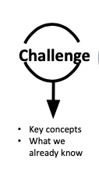
Starting point…
What is the problem you want students to engage with?
What do your students already know about it?
What are some key concepts/terminology?
Proposed activities
Visit nQuire for students: https://learn.nquire.org.uk/
As a teacher, design a questionnaire:
asking your students to share problems they would like to examine related to their school, local community etc.
Ask students to explain why they think these are important issues to study, understand, and find a solution for.
Alternatively…
As a teacher, identify the problem, go to www.extendt2.com, create a group, assign a group/groups that administrator has created to your group, create an activity, assign activity to the specific group, design a game using ChoiCo related to the problem you have chosen.
Ask students to play the game and share their understanding about the problem and extend it further.
Notes:
In this scenario, the issue is given by us - alternatively, you can ask students to discuss and identify which issues they would like to explore and find solutions for.

Slide 30
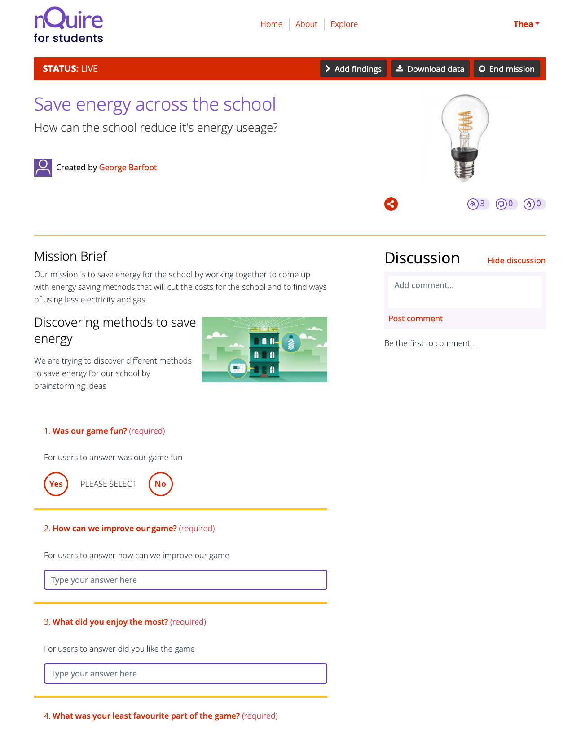
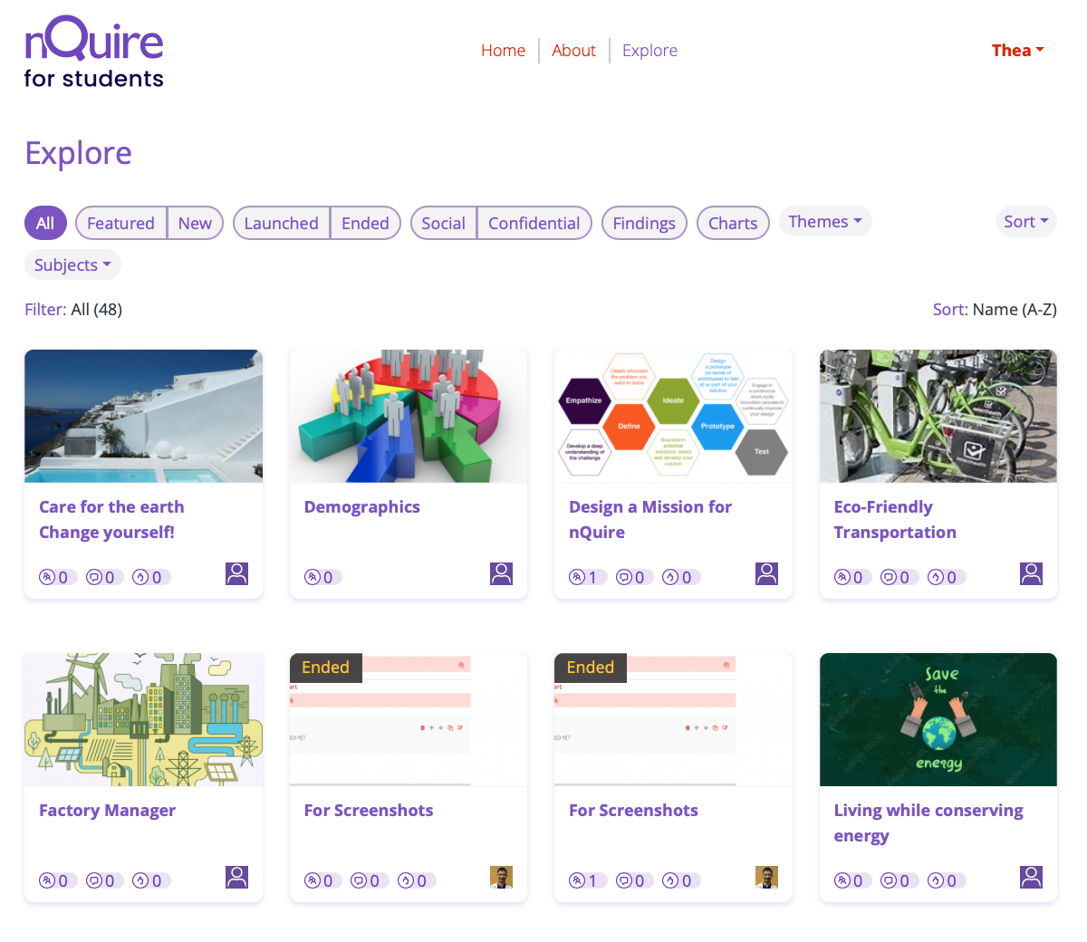
nQuire for students - an online tool to collect data
An online tool to:
design questionnaires
collect data about what people say, do, think, feel ("empathise" phase of design thinking)
collect feedback about your prototypes (solutions)
What is unique with nQuire for students?
Teaches students about the need for consent before collecting data
Encourages students to pilot and improve their prototypes (through a dedicated URL)
Enables the teacher to review and comment on a study before this is shared with others
Help! Here's some short videos explaining how to use nQuire for students:
How to log in: https://www.youtube.com/watch?v=Z6TIy2ggVKk
How to create accounts for students: https://www.youtube.com/watch?v=bTT-NvF2p_A
How to design a study ("mission"): https://www.youtube.com/watch?v=dEL8bEQyNPA&t=2s
How students can pilot their studies before they make them live [ to be added]

Slide 31
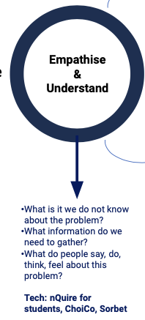
Step 1:
As a student, log in to nQuire for students: https://learn.nquire.org.uk/
To familiarise yourself with nQuire, try a demo study: https://learn.nquire.org.uk/mission/minimising-energy-consumption
Now create your own study about the issue you examine:
Go to: Create a mission from the menu under your username
Add at least 3 questions that would help you find out what other people are thinking/feeling about the problem
Set the study in pilot mode and share the URL in the chat
Take part in a study shared in the chat and leave your feedback by using Discussion (see right hand side)
In your feedback, consider e.g.
are the questions well formulated?
can they be improved? In what ways?
are there any mistakes?
Notes:
- go to nQuire.org.uk and design a questionnaire to collect ideas and opinions about the problem

Slide 32
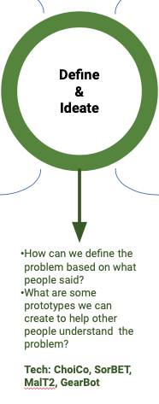
Step 2:
Log in to www.extendt2.com and go to ‘Define and Ideate’ block. As you have decided to use the game ChoiCo, it will direct you to the 'Choico' game: http://etl.ppp.uoa.gr/choico
To familiarise yourself with Choico, try a game already created about Covid 19: http://etl.ppp.uoa.gr/choico/?covid19survivor_Eng
Amend the game by pressing Edit
Delete a field
Add a new field
Add values to the new field created
Delete a choice
Now create your own game based on what you learnt from surveying people (in step 1)
Define how the game will be to achieve your goal
Think about (ideate):
Where the game will take place? (map area)
What choices the player will have?
What fields will be affected by their choices (game fields)
How they will be affected (database values)
When the game will end (end rules)

Slide 33
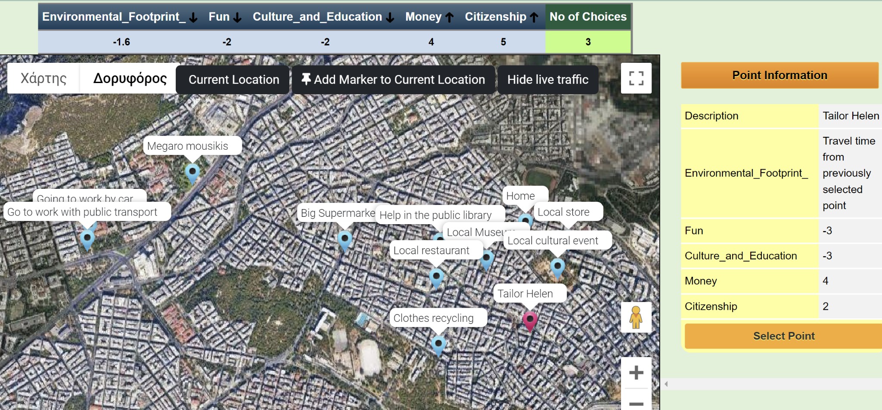
ChoiCo - an online game with consequences
Game Fields
The consequences of a choice made in the game
Game Scene (Google Maps)
Create choice-driven simulation games on a real map
Make choices with consequences to the game fields
You win if you make the larger number of choices

Slide 34
Choico: Video tutorials
Help!
Here's some short videos explaining how to use Choico
https://drive.google.com/drive/folders/1j5zice96L4pfF9GZkLkZbjgMQO7H8B-R

Slide 35
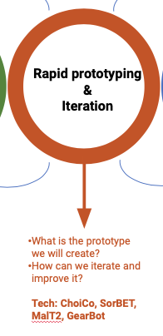
Step 3:
Log in as a learner on www.extendt2.com and click on Rapid Prototyping and Iteration Block
You will be directed to a ChoiCo game
Create a first demo of your game based on the parameters you defined in previous step
e.g., the demo can have 3-4 choices and one ending rule
Test your demo: Press the play button, use it as a player and save it.
While testing write down things that don’t work well or new ideas
Improve your demo: Press the “edit” button and edit your game
Test it with others: Give your improved game to at least one other student to play it. Ask them questions and keep notes as they use it; make changes accordingly.
Keep testing and improving the game until your team is satisfied by the result

Slide 36
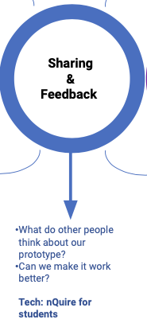
Step 4:
Log in to www.extendt2.com as a learner and click ‘Sharing & Feedback’ which will further direct you to nQuire for students: https://learn.nquire.org.uk/. Log in to the platform with your nQuire credentials.
Create a new study ("mission"): the aim is to collect feedback about your prototype from as many students as possible
Add at least 3 questions asking others to try your game and give feedback
Example questions:
What do you like about my ChoiCo game?
Is there anything you would like to change?
Is there anything missing?
Did you learn anything new after playing my game?
Would you recommend my game to others students? Explain why.

Slide 37
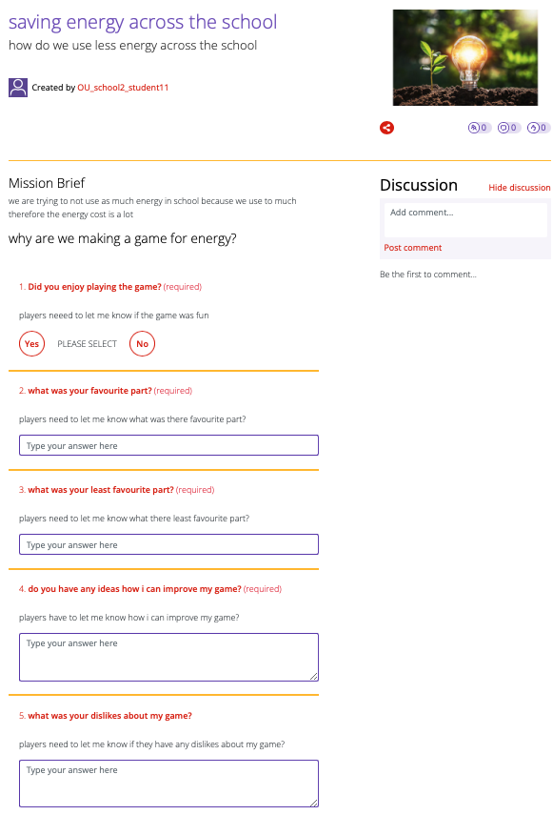
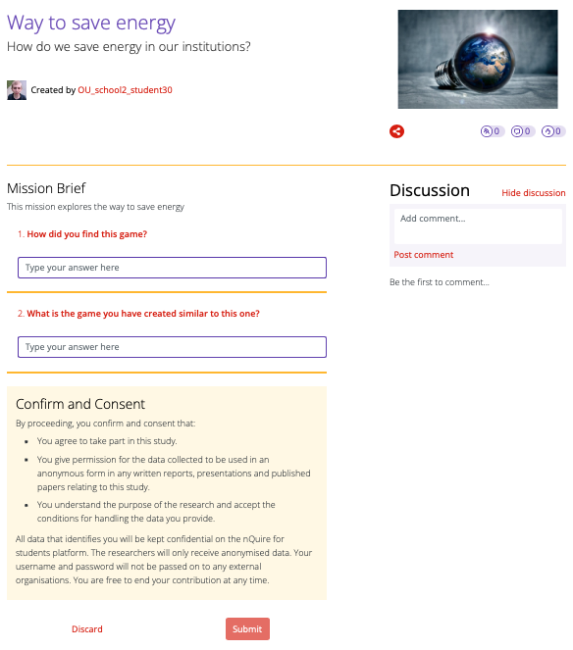
Example studies created by students in Year 1

Slide 38
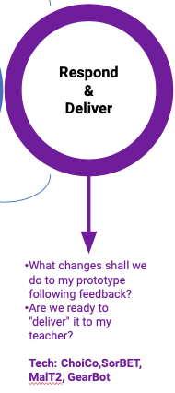
Step 5:
Check the responses to your study on nQuire for students (these are public so you can read them when accessing your study)
Read them all and note down what changes you can make to your prototype
Go to Choico and make changes as needed
It is fine if you cannot address all proposed changes or you have a reason to disagree with some of the suggestions.
When you finish, "deliver" your prototype to your teacher for assessment.

Slide 39
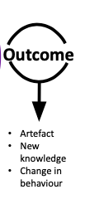
Ending point…
The outcome of a design thinking project at schools can look like:
A new digital artefact (e.g., a ChoiCo game)
A new physical artefact (e.g., 3D printed object)
New knowledge
Change in behaviour/attitudes
Development of news skills

Slide 40
Reflections: Plenary discussion (10 min)
What are your initial impressions of technologies?
Positive, negative, neutral
What would you like to improve on each technology?
Is anything missing?
Do you think there would be any issues/barriers using these technologies with students at your school?
Think of student age, technical skills, infrastructure, time, etc
Notes:
Try the game and reflect on it

Slide 41
Other technologies linked to the Exten(DT)2 platform

Slide 42
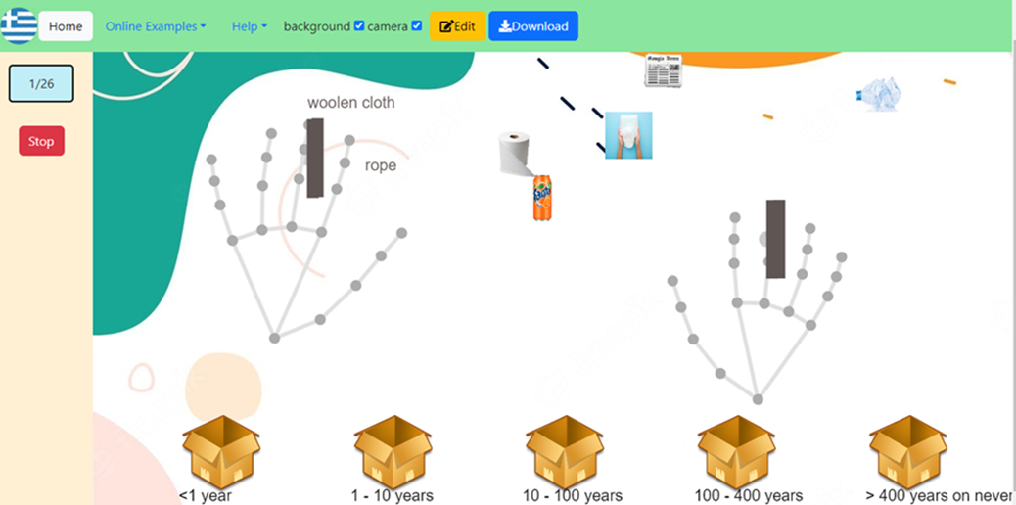
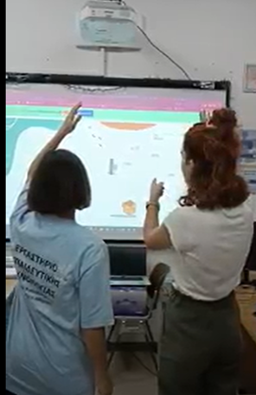
SorBET: Design & Play Augmented Reality (AR) classification games
Sort out items in categories (rapid decision making)
Two players can play simultaneously using their hands (with any computer camera) (collaboration, communication, discussions)
Figure above: an AR game that sorts material according to time needed for degradation
Example DT project: “design a game for the elderly to learn about the different uses of technology”
https://extendt2.eu/technologies/

Slide 43
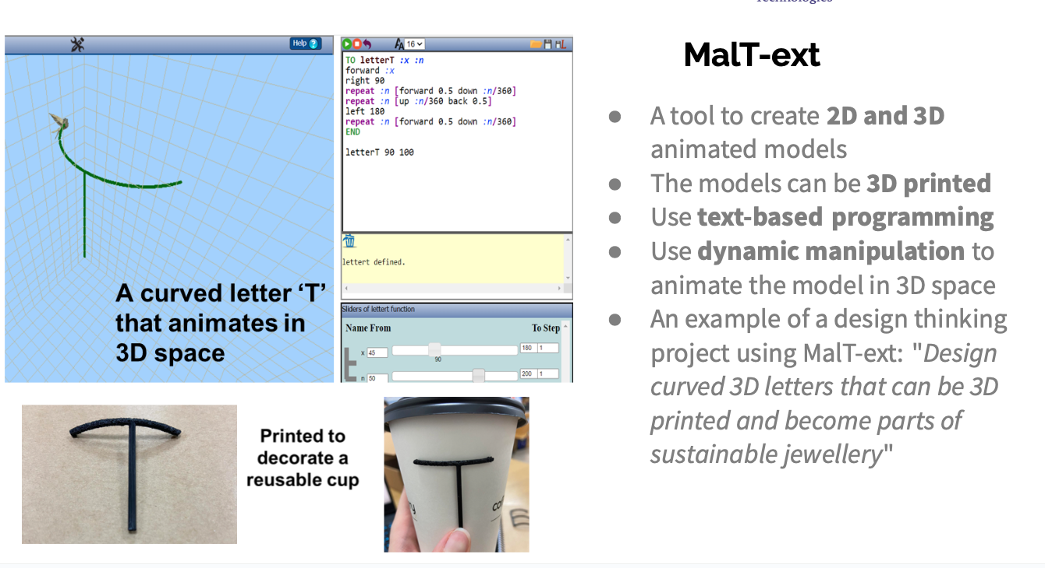
https://extendt2.eu/technologies/

Slide 44
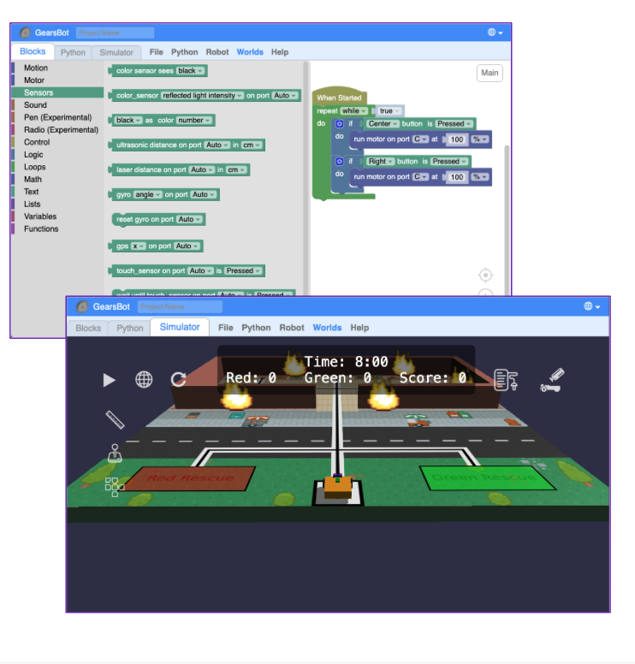
GearsBot
A tool that supports a 3D robotics simulator using either drag-and-drop blocks of code or Python
An example of DT project is to use one of the virtual “worlds” and make it fit in an imaginary scenario of a problem you may think about, or to choose a more advanced “world” like the “fire rescue” and try to improve how the robot is constructed and controlled to complete a rescue mission
GearsBot Mini Tutorial: https://youtu.be/Zc7tCtucLC8

Slide 45
Break time…5 minutes

Slide 46
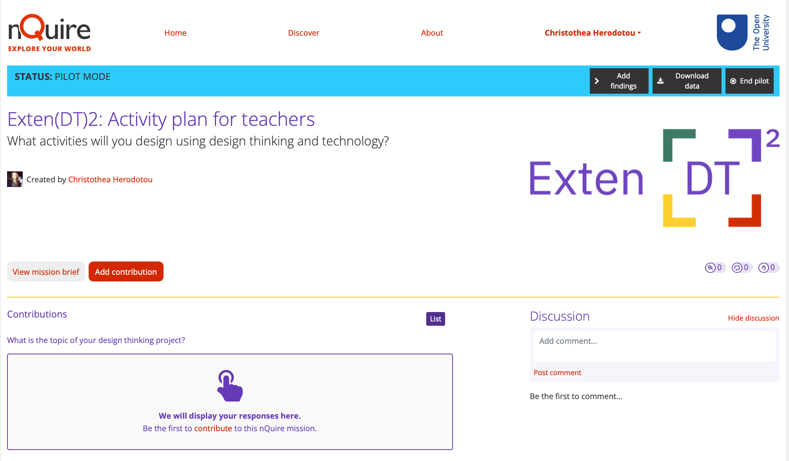
Activity plan template:
Produce your own design thinking project for your students

Slide 47
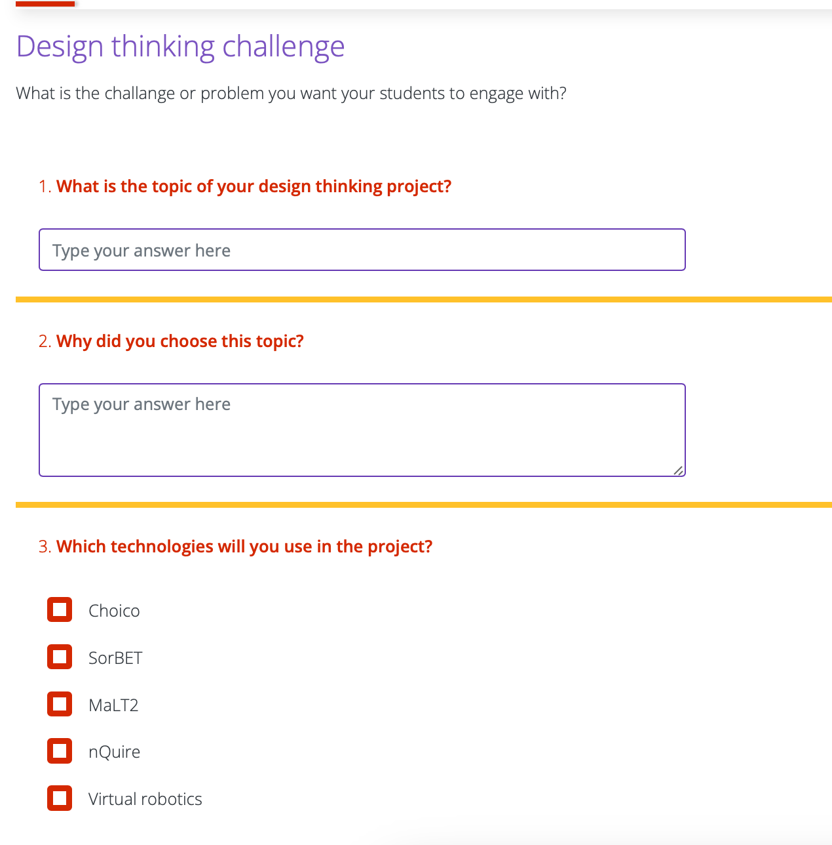
Activity plan template
You can find the activity plan template here: https://nquire.org.uk/mission/extendt2-activity-plan-for-teachers/data
Register and select: “add contribution” - add your responses to questions related to the below:
Design thinking challenge
Step 1: Empathise & Understand
Step 2: Define & Ideate
Step 3: Rapid prototyping & iteration
Step 4: Sharing & Feedback
Step 5: Respond & Deliver
Organisation: Space/settings (online, ftf, blended); Time/weeks; Student information (any special needs, etc)
Student learning outcomes

Slide 48
Activity 3: group work in break-out rooms (40 min)
Discuss and decide on a topic for your design thinking project
Fill in the respective fields in the activity plan template
Decide on the technologies and any other material you need to teach each stage of design thinking
Fill in the respective fields in the activity plan template
Decide on the learning outcomes of your activity
Fill in the respective fields in the activity plan template
Decide on how students will work together, how long this will take, and any other student considerations
Fill in the respective fields in the activity plan template
Submit your completed activity plan!
This will be made live for other teachers to read and get inspiration from!
You will be able to read the activity plans of others and leave your feedback!

Slide 49

End of training assessment (3 min)
Before we wrap up, we want to know what you think about this training!
https://bitly.ws/33Sd7
3 minute timer: https://youtu.be/iHdviZkM7S4?si=td4s5E95Vl6yUQMI

Slide 50
Next steps
Planning to implement your activity plans? Get in touch!
A "Case study" we observe and collect data from
Administer pre- and post-student questionnaires (only) and send them to us
Give us an interview sharing your experiences after you implement your activity plans
Receive a newsletter from the project (every 4 months)
Follow-up workshop dates: share with your colleagues!
Bespoke requests for delivering workshops at a single school
Contact details: extendt2@gmail.com
Thank you! Any questions?

Slide 51
Example learning objectives (with help from AI…)
Students will be able to identify the key factors that contribute to energy consumption.
Students will be able to apply the design thinking process to develop innovative solutions to reduce energy consumption.
Students will be able to evaluate the effectiveness of their solutions and make improvements as necessary.
Empathize: Students will be able to identify the key factors that contribute to energy consumption.
Define: Students will be able to articulate the problem statement and define the scope of the project.
Ideate: Students will be able to generate a range of innovative solutions to reduce energy consumption.
Prototype: Students will be able to create a prototype of their solution.
Test: Students will be able to evaluate the effectiveness of their solutions and make improvements as necessary.

